Slide 1
Trouble in the Colonies
Part 3-
More Problems with the Colonists

Slide 2
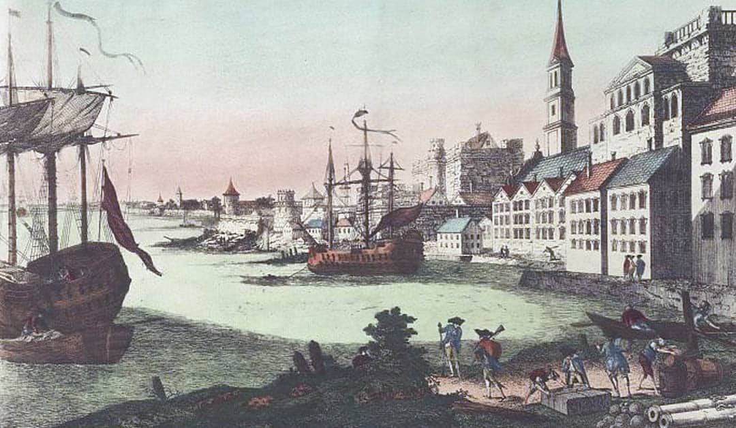
Because the boycott of British goods hurt British trade, the Townsend Acts were repealed shortly after the Boston Massacre. Only a tax on tea remained.

Slide 3
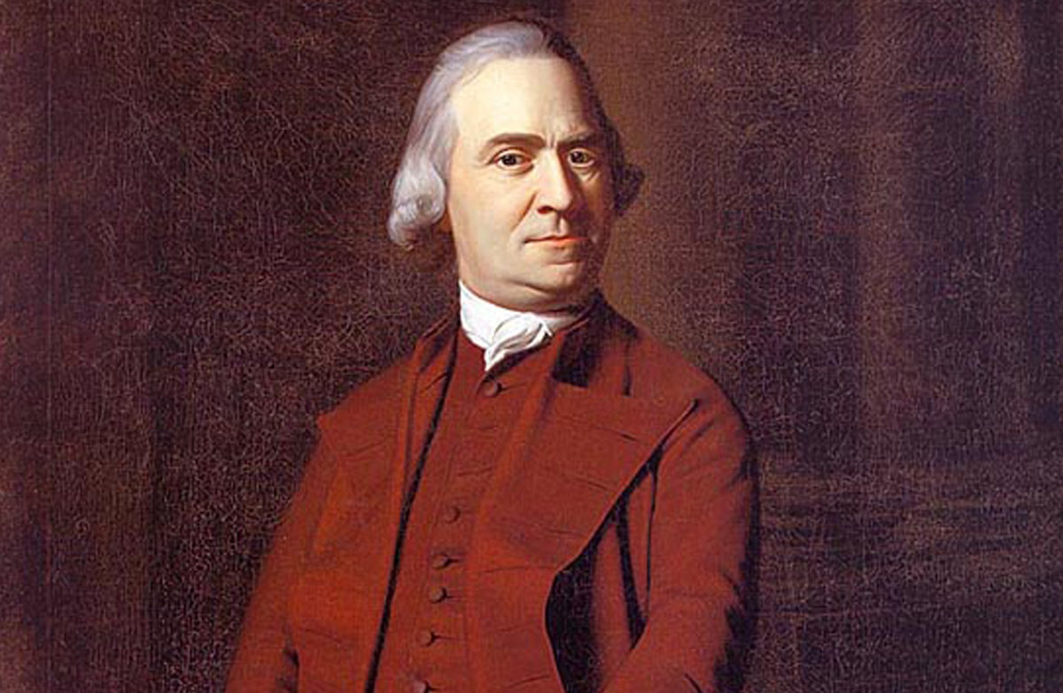
Most colonists were happy and now content. However, some colonists like Samuel Adams did not want people to forget the cause of liberty.

Slide 4
What do you think??
How do you think it would have been possible back in the 1700s for large groups of people who lived far apart to communicate and organize activities without using newspapers and broadsides?

Slide 5
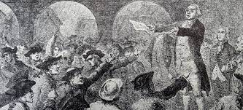
In an effort to be in contact with other Patriots (colonists who were looking towards independence), in 1772 Adams formed a group called the Committee of Correspondence.

Slide 6
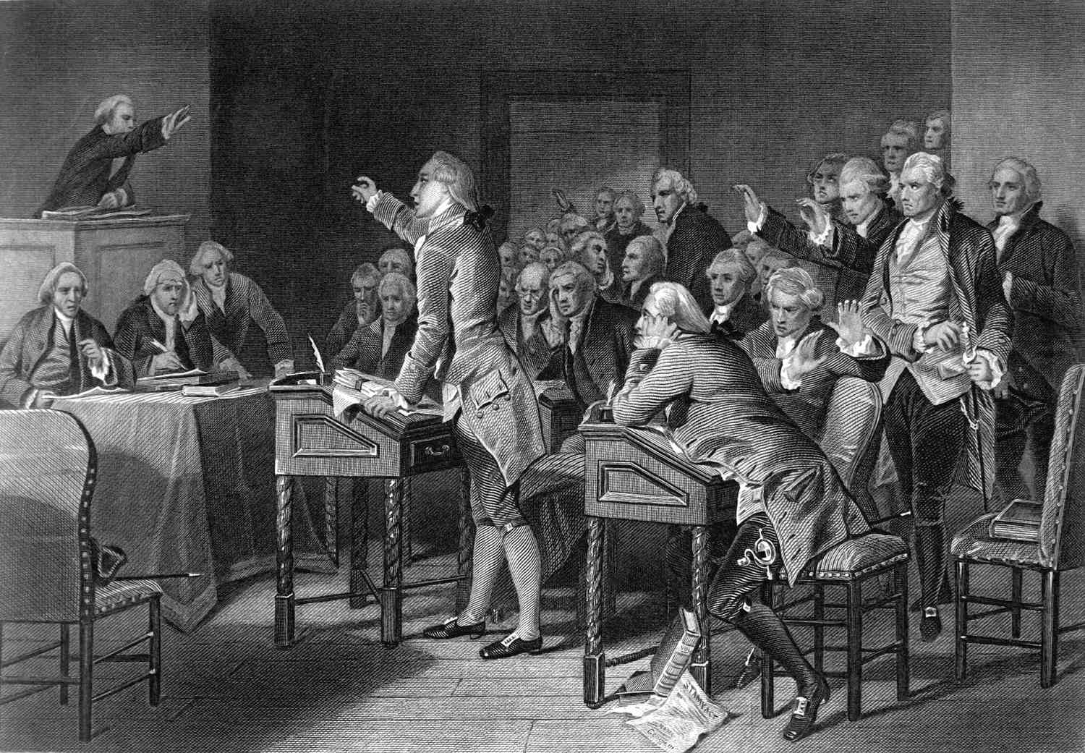
This idea spread, and in 1773 the Virginia House of Burgesses formed its own committee of correspondence to open up communication between the colonies.

Slide 7
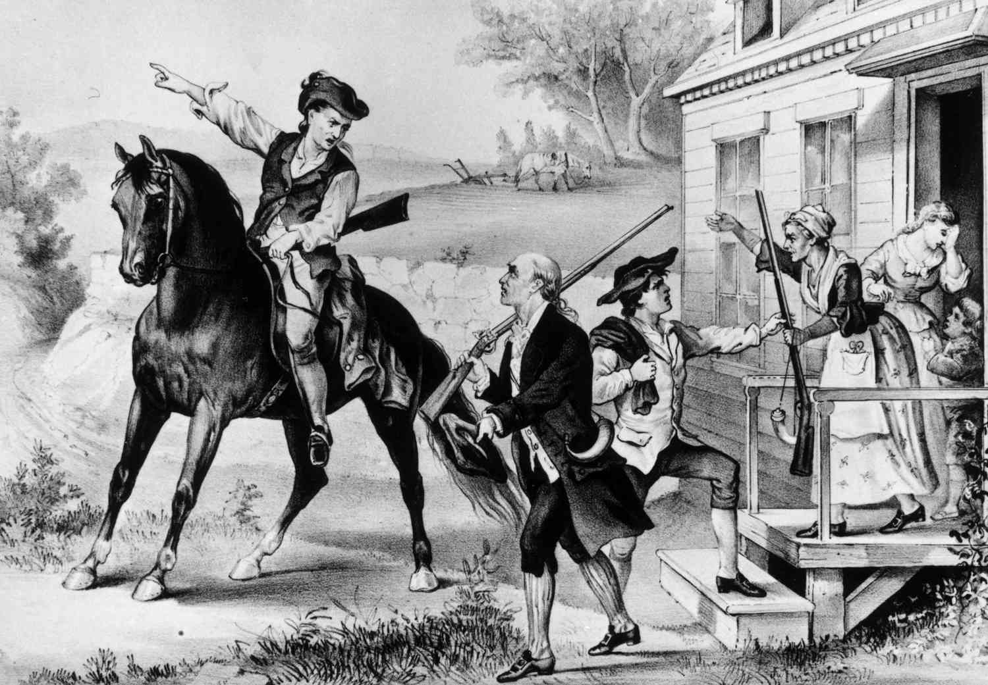
By the end of 1774, 11 of the 13 colonies had Committees of Correspondence spreading news and information about the Patriot cause and organizing opposition to British policies in cities, towns, and rural communities throughout the colonies.

Slide 8
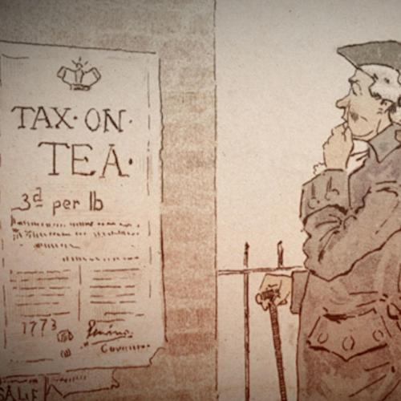
In an effort to help the British East India Company, Parliament gave them total control of the tea trade in America by passing the Tea Act in 1773.

Slide 9
Even though tea brought into America by the British East India Company was cheaper than even smuggled tea, many colonists were upset. Why do you think that happened?

Slide 10
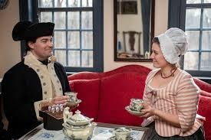
Reasons why some colonists were upset about the Tea Act of 1773:
It hurt colonial shippers and merchants’ business.
2. If Parliament could do this with tea, what might be next?

Slide 11
Colonists protested in different ways. In Charleston, they stored the tea in damp basements so it would rot. In Philadelphia and New York City they turned away ships carrying tea.
Robinson Tea Chest:

Slide 12
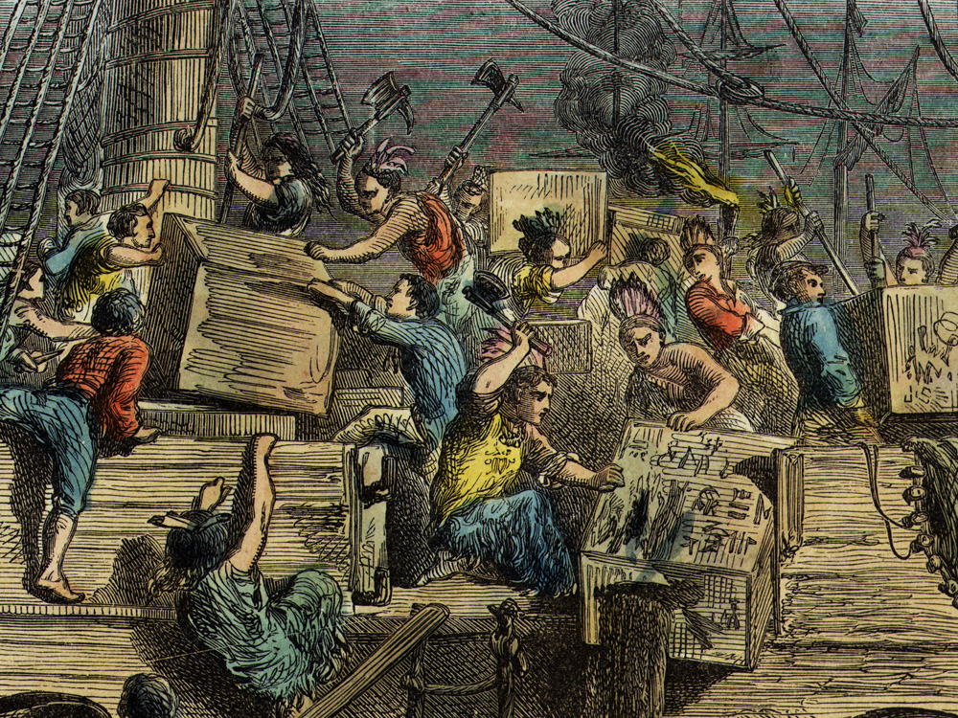
On December 16, 1773, in Boston, Sons of Liberty boarded three cargo ships in Boston Harbor and destroyed 342 chests of tea. This became known as the Boston Tea Party.

Slide 13
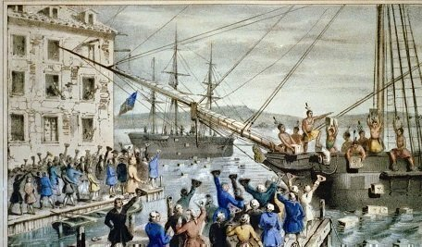
There was mixed reaction to the Boston Tea Party. Some colonists, like John Adams, thought it was a great event. Others, like George Washington, did not approve.

Slide 14
Think About It
Why do you think some Patriots like George Washington thought the Boston Tea Party wasn’t a good idea?

Slide 15
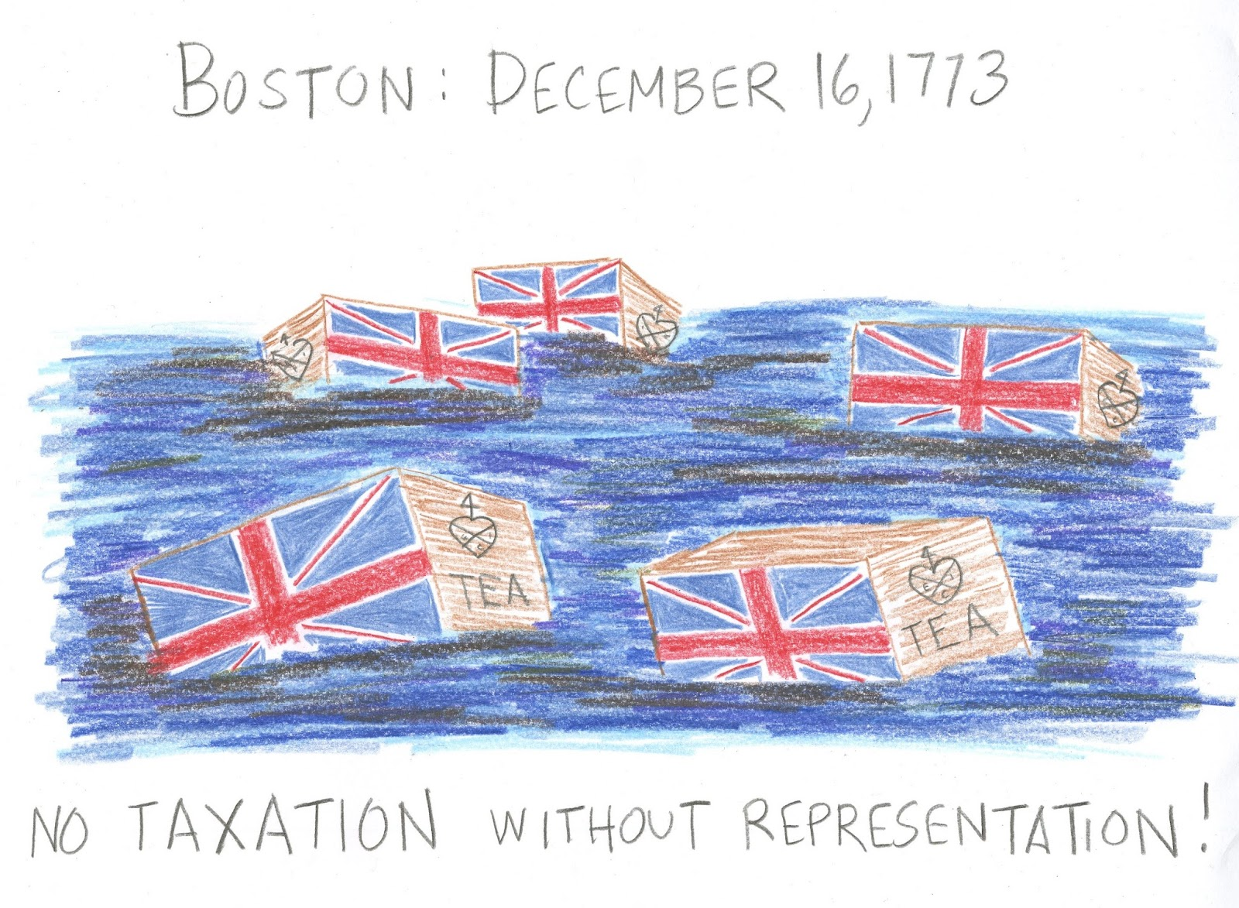
Fearing British punishment, Benjamin Franklin thought that the British East India Company should be paid back for their loss. He even offered to pay it if Parliament would repeal the Tea Act.

Slide 16
Taxes, Tea, and Tyranny Video

Slide 17
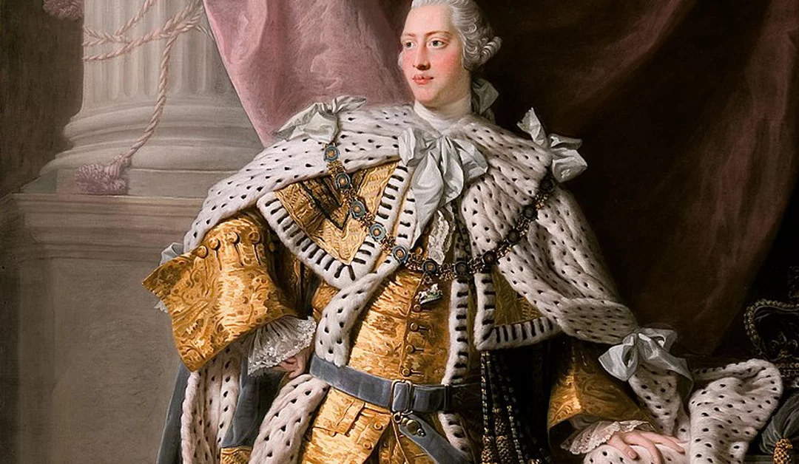
King George III and Parliament were furious when they found out about the Boston Tea Party. In response, they issued the Coercive Acts of 1774. Colonists thought they were so terrible that they called them the Intolerable Acts!

Slide 18
The Intolerable Act did the following:
Closed the port of Boston to all ships.
Restricted representative government in Massachusetts.
Allowed British commanders to house troops wherever necessary.
Allowed British officials accused of crimes to stand trial in Britain instead of the colonies.

Slide 19
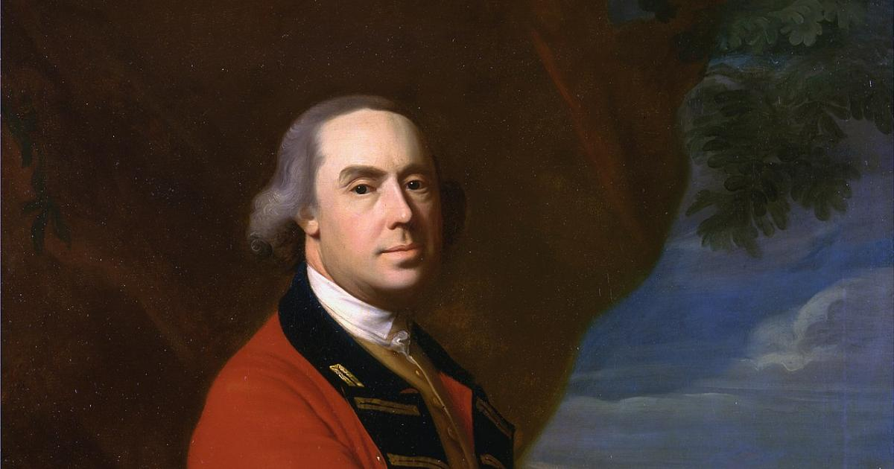
To be able to enforce the Intolerable Acts, General Thomas Gage was named the governor of Massachusetts.

Slide 20
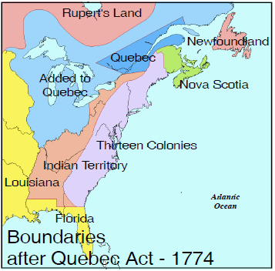

Slide 21
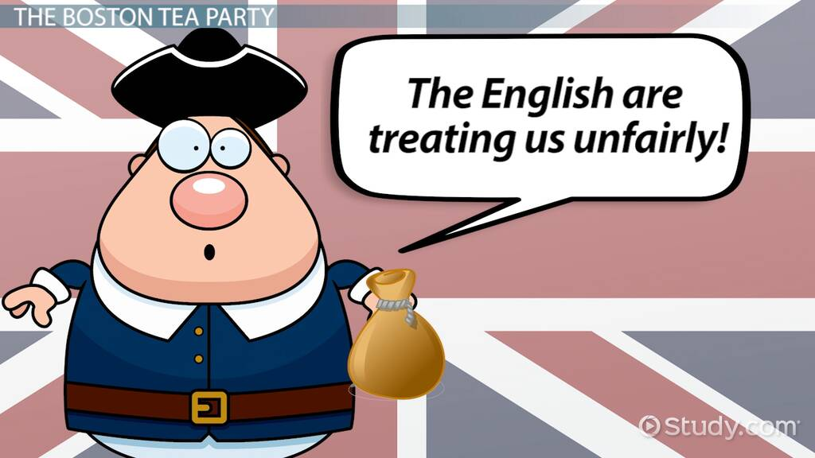
Even though the Intolerable Acts focused on punishing the Massachusetts colony, specifically Boston, many people from all the colonies were outraged!

Slide 22
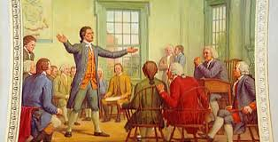
In response to this, the Committees of Correspondence called for delegates from the colonies to meet together to discuss what to do. This meeting became known as the First Continental Congress.

Slide 23
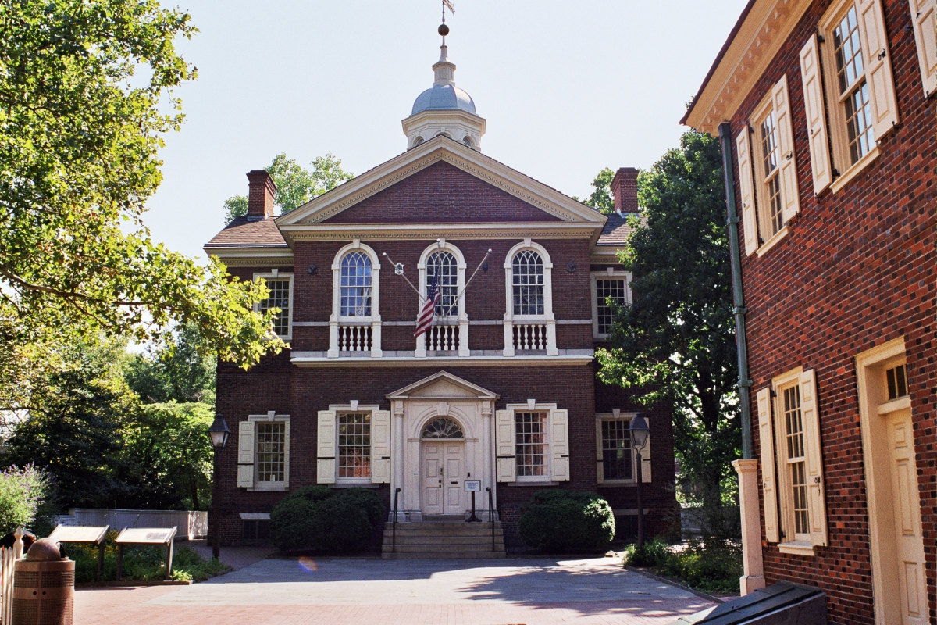
Fifty-six delegates from 12 of the original 13 British colonies met in Philadelphia in September of 1774 to discuss what to do with the increasing problems with Britain. Georgia was not represented.
Carpenter’s Hall

Slide 24
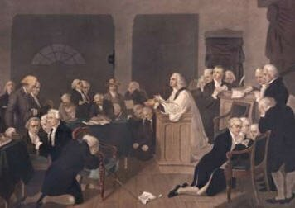
There was a wide range of ideas of how to move forward. Some delegates wanted to break away from Britain. Most wanted to try to work out the problems.

Slide 25
There was much debate, and after two months the delegates came up with the following plan:
The colonies were going to break off all trade with Britain until the Intolerable Acts were repealed.
They appealed to the King to listen to their grievances.
They organize militias.
They decided to meet again if Britain didn’t agree to try to fix any of the problems.

Slide 26
Exit Question
The First Continental Congress was actually illegal. Why do you think the members decided to take the risk to meet?

